Slide 1


SMART BATTERY MANAGEMENT AND THERMAL PROTECTION SYSTEM WITH GSM ALERTS AND CLOUD INTEGRATION
Presented by:
ムンナム . バヴィヤ
Electronics and Communication Engineering

Slide 2
OBJECTIVE
Battery management is important for efficiency and safety in energy storage systems.
Overheating and improper usage can reduce battery life and cause failures.
This project develops a smart system for real-time battery monitoring.
This system also provides battery parameters via on OLED display.
Cloud-based analytics help in better performance monitoring and decision-making.

Slide 3
METHODOLOGY
BMS Design – ESP32-based battery management system.
Integrated thermal sensors and Peltier modules for heat management.
Developed a real-time monitoring dashboard.
Simulated temperature, humidity, and smoke conditions in testing.
Used TEC cooling to prevent overheating.
Improved prediction models for better battery health estimation.

Slide 4

MATHEMATICAL FORMULATION OF THE PROBLEM
The Kalman filter is an advanced recursive algorithm used for estimating the State of Charge (SOC) and State of Health (SOH) of batteries by filtering noise and improving measurement accuracy. It is widely used in Battery Management Systems (BMS) due to its capability to provide real-time estimation even in the presence of uncertainties.
1. State of Charge (SOC) Calculation
The State of Charge (SOC) represents the available energy in the battery relative to its full capacity. It is calculated as:
SOC(t)= SOC(t−1) +$\frac{1}{C_{nom}}$∫I(t)dt
Where:
SOC(t) = State of Charge at time t
SOC(t−1) = State of Charge at the previous time step
-(proposed by Rudolf E. Kalman)

Slide 5
BLOCK DIAGRAM
Cloud
OLED Display
Voltage Sensor
Voltage Sensor
GSM alerts
DHT22 Sensor
ESP_32
Microcontroller
Battery
Coolant
Smoke Sensor
Relays
Current Sensor
Buzzer

Slide 6
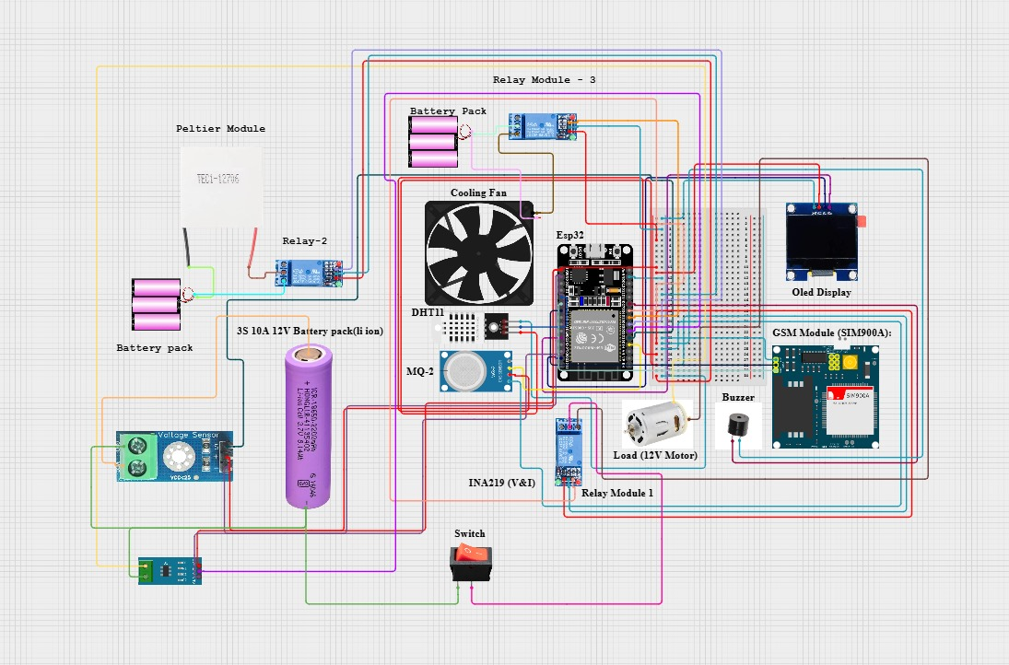
SCHEMATIC DIAGRAM
Fig.1

Slide 7
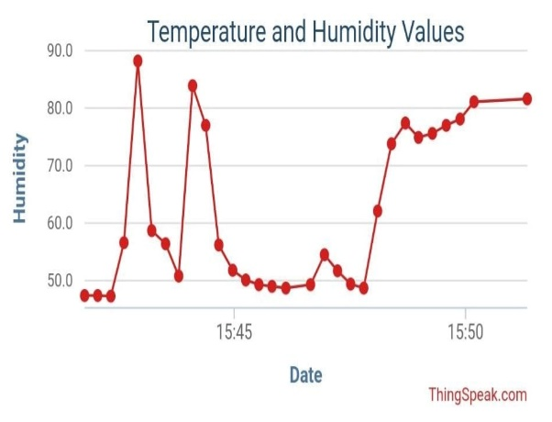
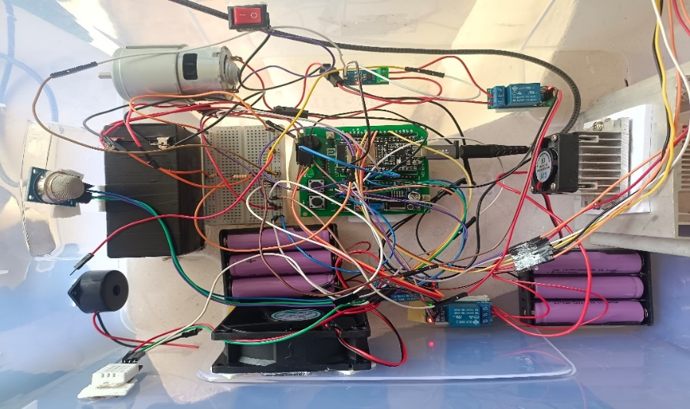
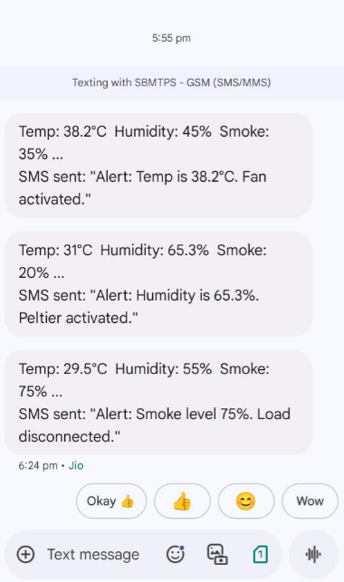
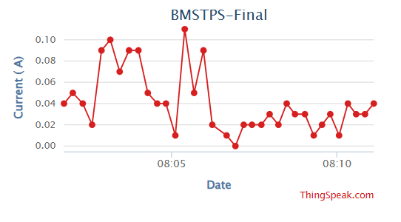
RESULTS
Fig.2
Hardware Implementation
Fig.3
GSM alerts
Fig.4
Analysis using cloud

Slide 8
CONCLUSION
The project successfully developed a smart battery management system that improves efficiency, safety, and lifespan. With real-time monitoring, automated protection, and cloud integration, it provides a reliable solution for battery management. Future enhancements include AI-based battery health prediction, 5G integration, and expansion to EV and industrial applications.

Slide 9
FUTURE SCOPE
AI-Based Battery Health Prediction – Implement machine learning to predict battery failures before they occur.
Advanced SoC & SoH Estimation – Use improved algorithms for even more accurate battery life calculations.
5G & IoT Integration – Enable faster, real-time remote monitoring and control via next-gen connectivity.
Smart Vehicle Applications – Adapt for electric vehicles (EVs) to enhance battery safety and longevity.
Industrial & Grid Applications – Scale up for power grids, factories, and large-scale energy storage solutions.

Slide 10
ありがとうございます

